Slide 1
React with Typescript
Basic overview

Slide 2
Topics
What is Typescript?
Typescript Core Features
What is react?
Who uses it?
How it differs from Angularjs?
Sample Application
Additional Resources
QA

Slide 3
What is Typescript
“TypeScript is a strongly typed programming language that builds on JavaScript, giving you better tooling at any scale.” – https://www.typescriptlang.org/
Created and maintained by Microsoft.
It’s a typed superset of JavaScript

Slide 4
Typescript Core Features
Editor Checks
Auto-complete
Interfaces
JSX (JavaScript XML)

Slide 5
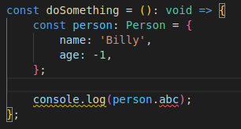
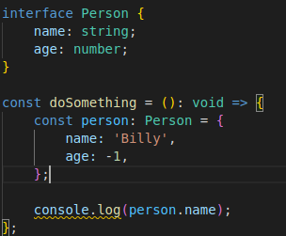
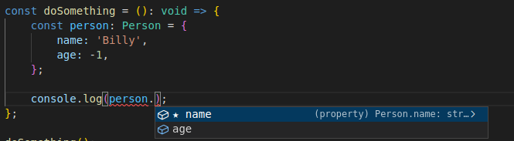
Typescript Core Features (continued)
Editor Checks
Interfaces
Auto-completion
JSX

Slide 6
What is React?
Original Author accredited is Jordan Walke
Maintained by Meta (Facebook) and community
Free open-source frontend JavaScript library for user interfaces
In React, you design views for each state of your app, and React updates and renders on those changes.

Slide 7
Who uses it?
Facebook
Instagram
Netflix
etc.

Slide 8
How it differs from Angularjs?
React | Angularjs
Virtual DOM | Real DOM
One-way data binding | Two-way data binding
Flux | MVVM (Model-View-View-Model)

Slide 9
Sample Application
https://github.com/tonylulciuc/poke-app

Slide 10
Additional Resources
React has a set of free courses: https://reactjs.org/community/courses.html
State & Lifecycle: https://reactjs.org/docs/state-and-lifecycle.html
App State Managment:
Redux: https://redux.js.org/
MobX: https://mobx.js.org/README.html
Recoil: https://recoiljs.org/
Etc.
Testing:
Enzyme w/ Jest: https://enzymejs.github.io/enzyme/docs/guides/jest.html
React testing library: https://testing-library.com/docs/react-testing-library/intro/

Slide 11
Q&A

